Slide 1

Web Technologies
Project Presentation

Slide 2
GRAB UR SITE http://grabursite.ml/
Submitted by
T.DEEPTHI 16121A12A1
T.NARASIMHA 16121A12A2
T.MURALI KRISHNA 16121A12A3
K.TRIDEEP 16121A12A4
U.CHANDRA JYOTHI 16121A12A5
V.S ASHA 16121A12A6
V.ANEELA REDDY 16121A12A8
V.SPANDANA 16121A12A9

Slide 3
Index
Abstract 4
Introduction 5-6
Modules 7-12
Results 13-21
Designs 22-24
Future enhancement 25
Conclusion 26
References 27

Slide 4
Abstract
This project provides user with various websites available in one website. This is an internet using site that makes searching of apps easier.
Many websites are available in this project regarding transport, local media, online shopping, moodle cloud and programming club.
Having many websites in one site the user can save time and can grab ay site with one login. This proposed project is designed to interconnect people with many websites.

Slide 5
Introduction
This grab your site project is a form of electronic commerce to directly interact with websites over the internet using a web browser. In this single website one can navigate to many websites and will grab one site. This project describes how to own multiple websites in separate sub folders on a single domain. In this scenario, you do not need to obtain new domains for each site.
We can find various types of mobile applications in one page we have different categories of apps on transportation, social media, educational apps, music apps etc. On selecting the category we will find apps related to that category and can navigate to that app. In login and sign up page allows user to login to the website. If the user is a new user then the person must sign up. They are needed to provide their details like name,mail id, username, password etc. The login details are stored in database in backend.

Slide 6
Introduction
The aim of this project is to provide users many websites in single site to grab ther wished site and it is developed using HTML5, java script ,CSS, PHP. This applications are very useful where the users can directly navigate to the website from home via internet on mobile or system.

Slide 7
Modules
Registration
Login
Select category
Choose a site
reviews

Slide 8
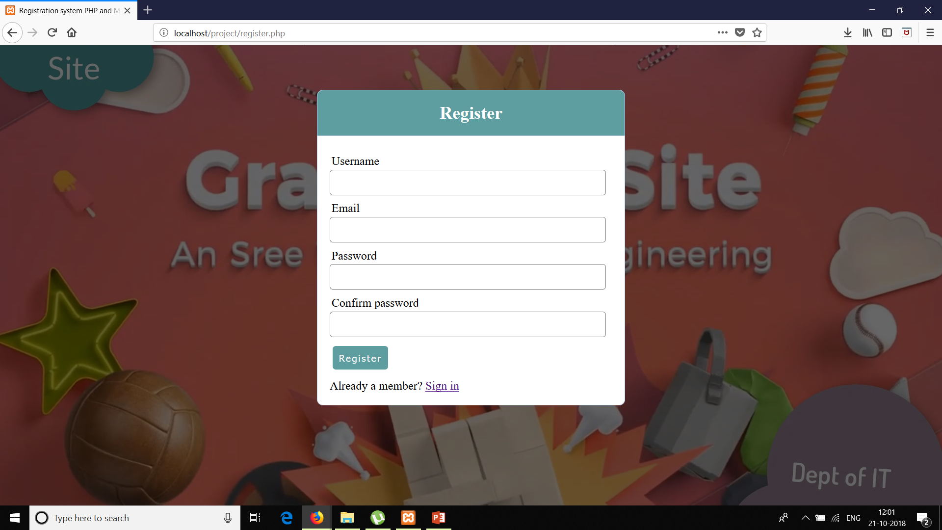
Registration

Slide 9
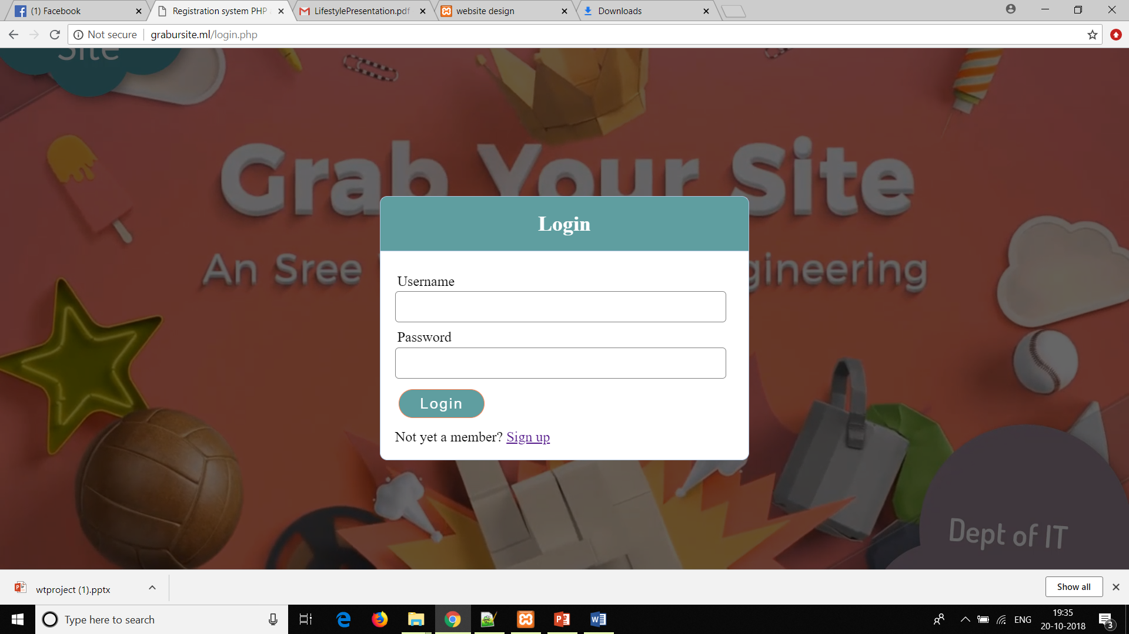
Login

Slide 10
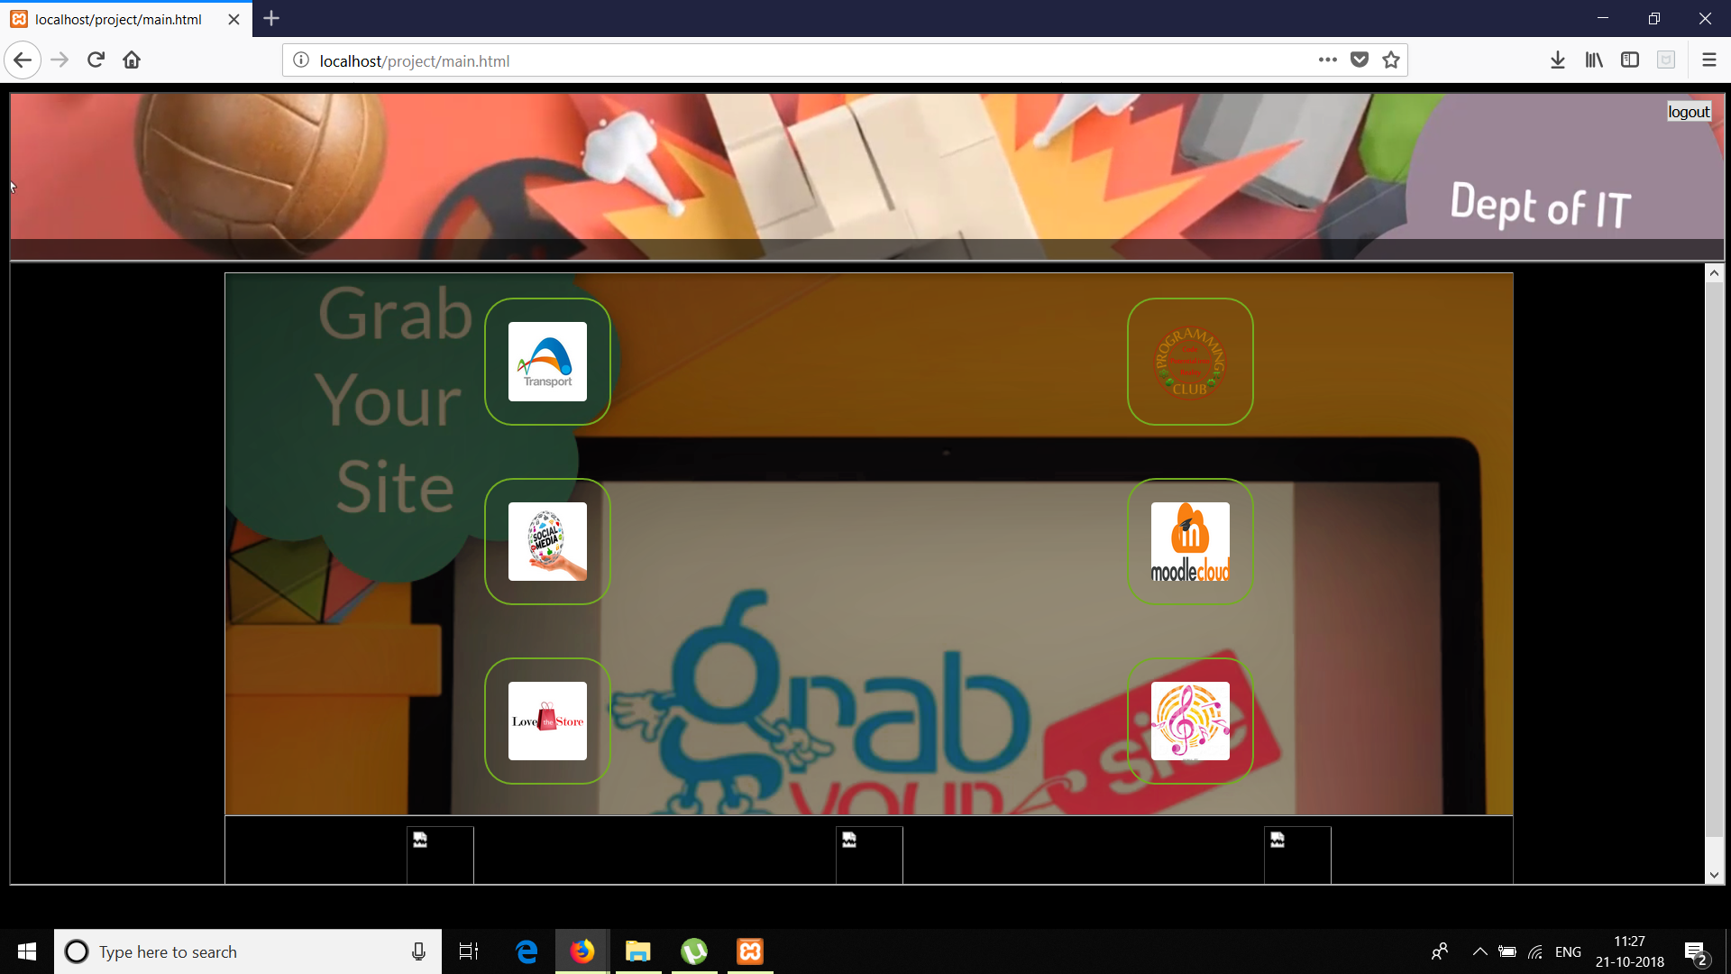
Select category

Slide 11


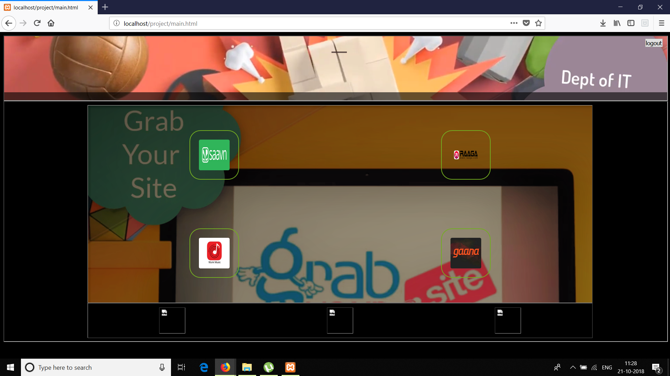


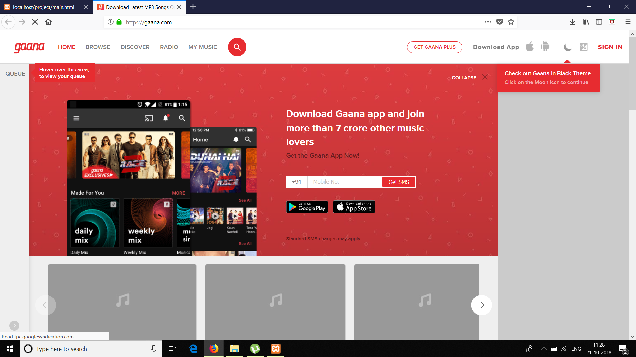

Choose a site

Slide 12
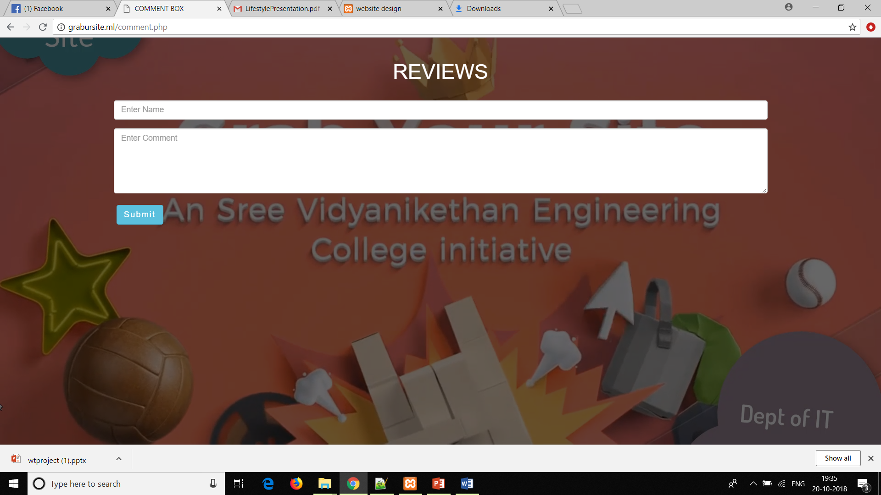
Reviews

Slide 13
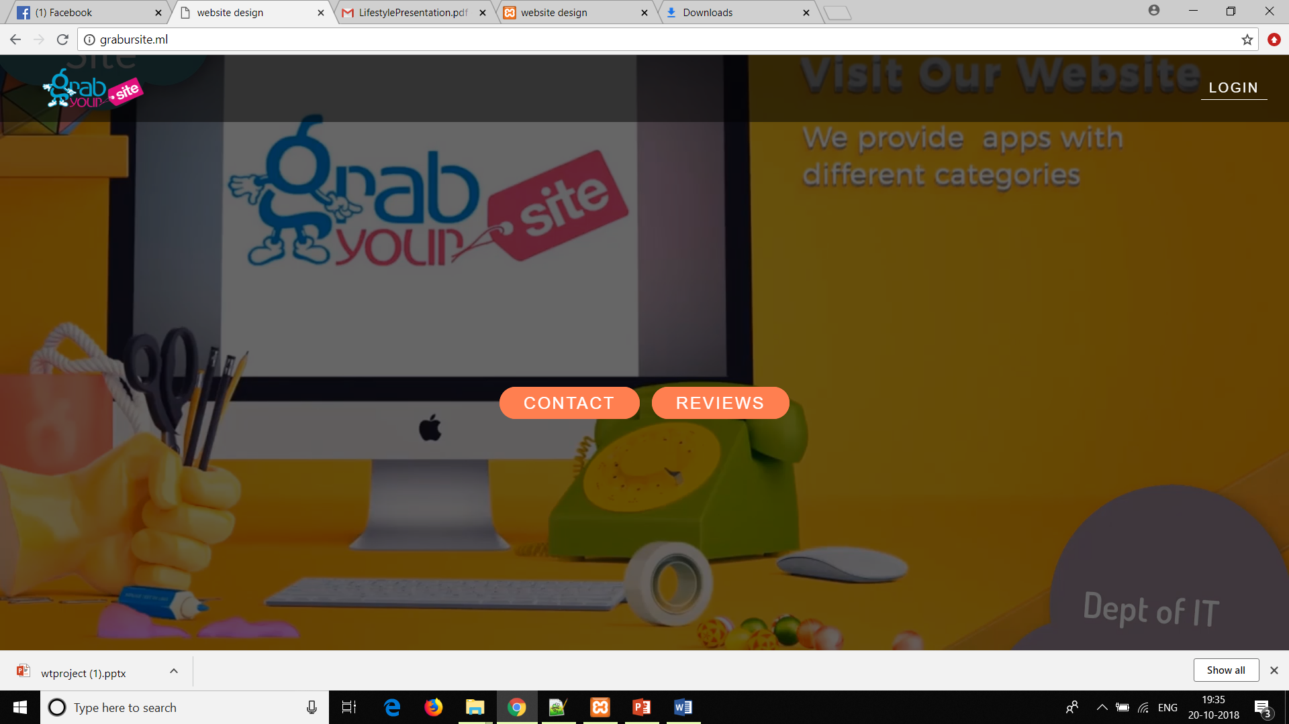
Resutls-Screenshot-1

Slide 14
Screenshot-2

Slide 15
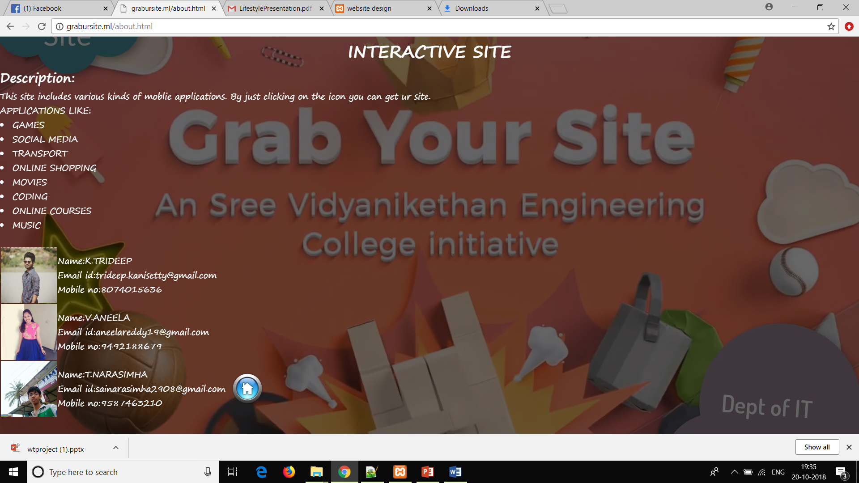
Screenshot-3

Slide 16
Screenshot-4

Slide 17
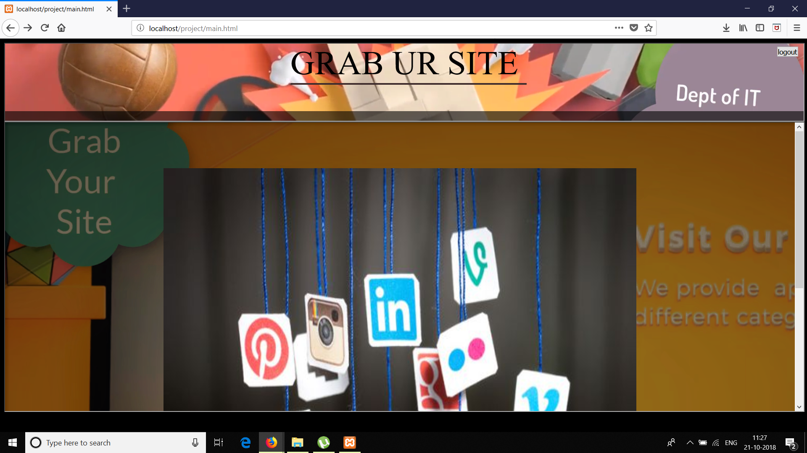
Screenshot-5

Slide 18
Screenshot-6

Slide 19
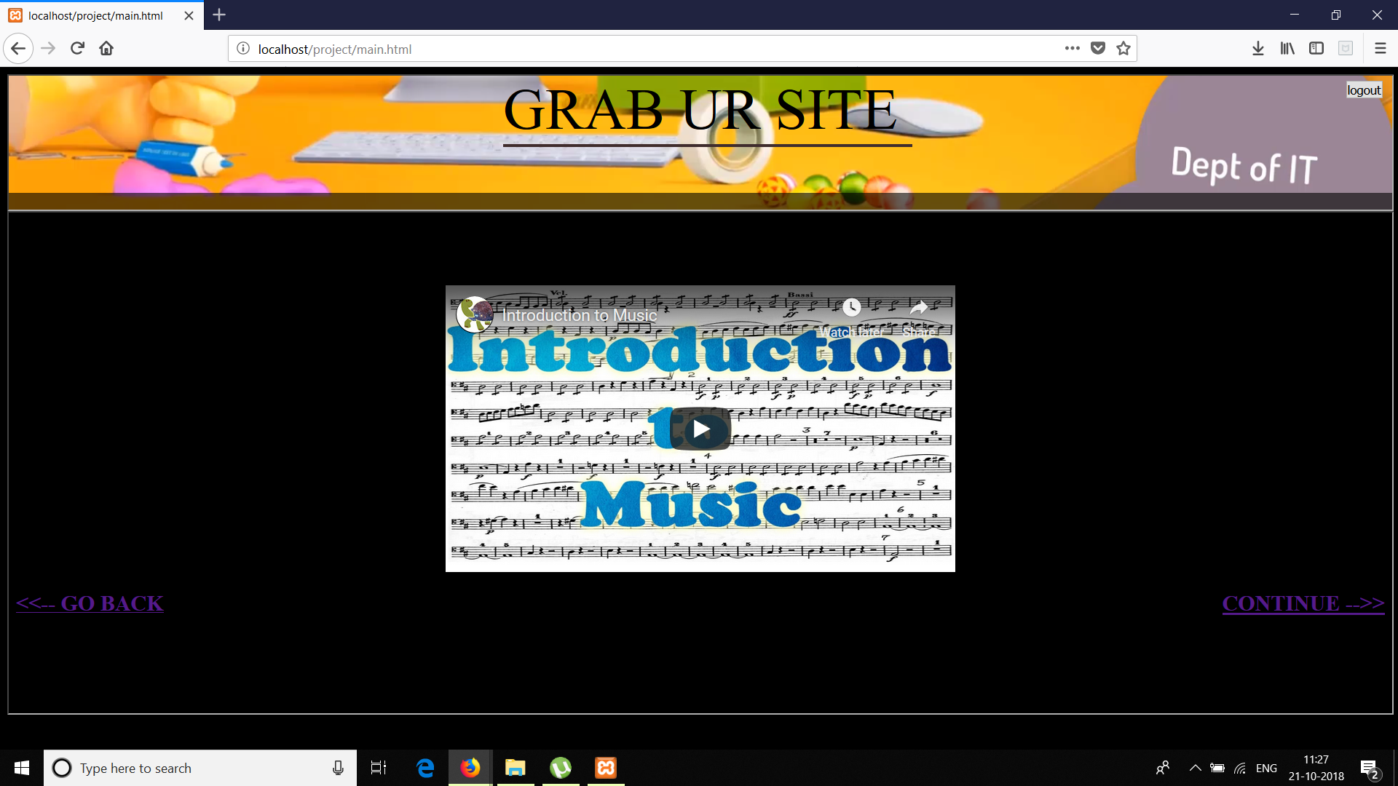
Screenshot-7

Slide 20
Screenshot-8

Slide 21
Screenshot-9

Slide 22
Design

Slide 23
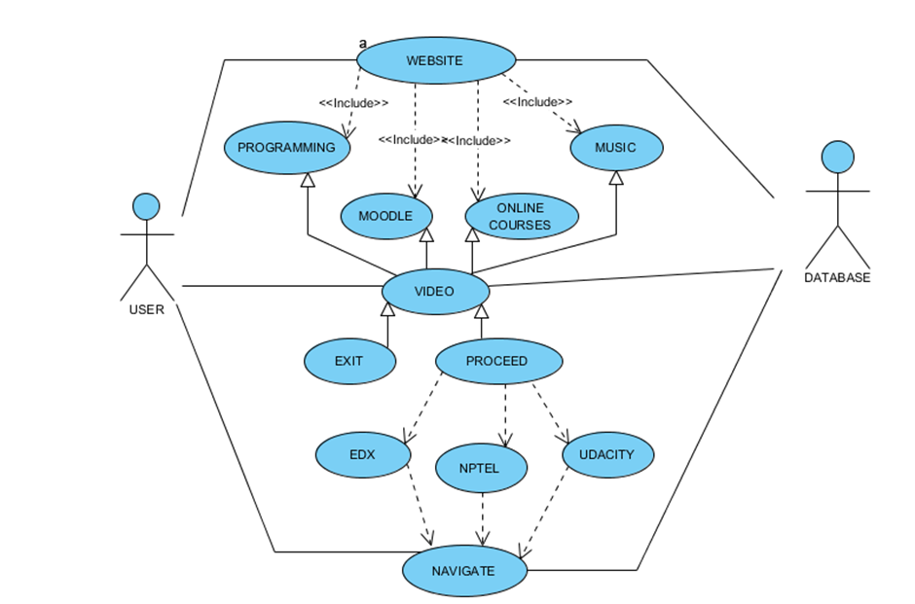

Slide 24
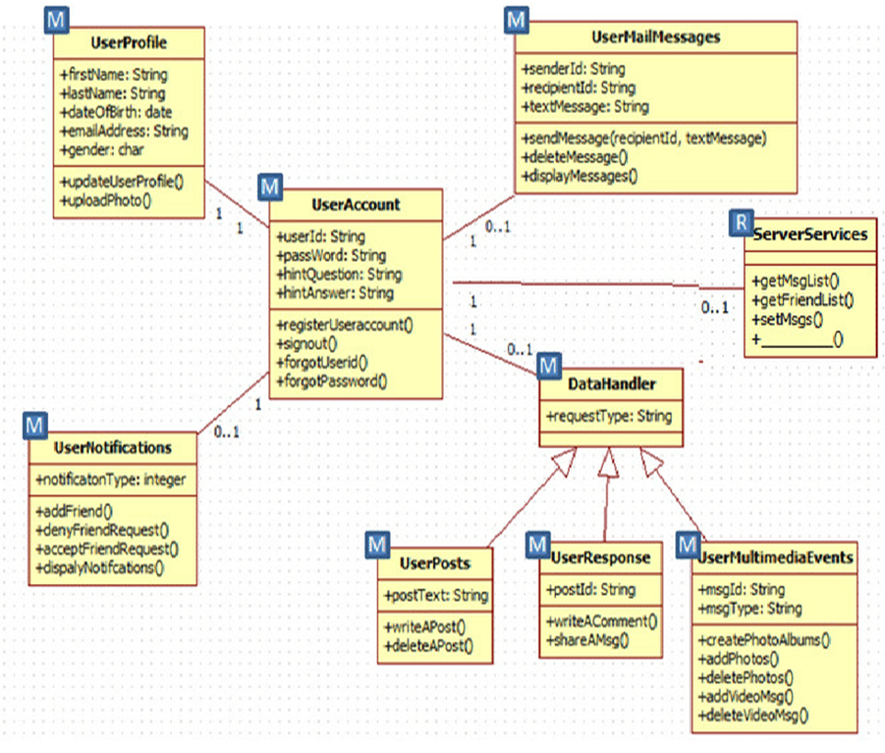

Slide 25
Future enhancement
Website enhancements improve your online image
Work directly with expert designers to make advanced design updates, embed audio and videos files, and link to online resources.
Website interactions made easy
Make your website more functional, engaging and appealing — providing a user friendly experience that encourages repeat visits.
Customize your website with various enhancements including flash file integration, photo faders, links to online resources and more. Let our expert design team breathe new life into your old website with a complete redesign. Check out our Website Design Services.
Are you selling products online? Let us build your storefront through our Ecommerce Web Design Services.
What does your logo say about your business? Establish your identity with our Logo Design Services powered by Logoworks®.
Keep your site current and relevant with our Website Maintenance Services.

Slide 26
Conclusion
After having a detail study on this grab your site, one can get great benefits that is having many websites in single site. One can save time and energy by entering once into this website through the login page. Our website makes you to share images, videos, audios, project files easily commenting on each and every upload is a good one in our website. It is the best website to improve your knowledge with our forum. Availability of various kinds of apps in one place is the another best thing in our website.
The package was designed in such a way that future modifications can be done easily. It gives appropriate access to the authorized users depending on their permissions. System security, data security and reliability are the striking features. It provides a friendly graphical user interface which proves to be better when compared to the existing system. Automation of the entire system improves the efficiency. The system has adequate scope for modification in future if it is necessary.

Slide 27
Reference
[1]. Kogent Learning Solutions Inc, HTML 5 Black Book: Covers CSS3, JavaScript, XML, XHTML, AJAX, PHP and jQuery, Dreamtech Press, Second Edition, 2016.
[2]. W. Jason Gilmore, Beginning PHP and MySQL, APress, Fourth Edition, 2011.
[3]. Snig Bahumik, Bootstrap Essentials, PACKT Publishing, 2015. (e-book).
[4].https://www.tutorialspoint.com/web_development_tutorials.htmhttps://www.tutorialspoi nt.com/web_development_tutorials.html
[5]. https://www.w3schools.com/
[6]. https://www.lucidchart.com/blog/uml-diagram-templates
[7]. https://www.javatpoint.com/html-tutorial
[8]. https://developer.mozilla.org/en-US/docs/Web
[9]. UNIFIED MODELING LANGUAGE By Gradi Booch,Ivar Jacobson, James Rambaugh
[10]. https://mva.microsoft.com

Slide 28


